Slide 1



Introduction to Deep Learning
José Antônio MIRANDA MATTEI
Songhao GAO
Laboratory of Vibration and Acoustics (LVA), INSA Lyon
LVA Winter School - 2026
Prof. Jérôme ANTONI
Valmorel, France - 23/01/2026
jose-antonio.miranda-mattei@insa-lyon.fr / songhao.gao@insa-lyon.fr
Notes:
Hi everyone. In this short talk, I’ll give a beginner-friendly view of deep learning and how PyTorch fits into the workflow. The goal is not to make you experts, but to make the training loop feel intuitive: forward pass, loss, backpropagation, and evaluation

Slide 2
Table of Contents
Introduction
Machine Learning, Deep Learning & Generative AI
Basic Structure of a Deep Neural Network
Building Blocks of Deep Learning
Forward propagation: inputs, neurons, activation functions, prediction, loss
Backward propagation: automatic differentiation, weight updates, regularization
Evaluation
Final Model & GridSearch
Error Metrics
Learning Curves
Introduction to Deep Learning : On the use of PyTorch
Notes:
I’ll start with a quick map of AI/ML/DL/GenAI, then we’ll open the black box: what a network computes in the forward pass, how we define a loss, how gradients update weights, and how we check if the model generalizes.

Slide 3
Introduction

Slide 4
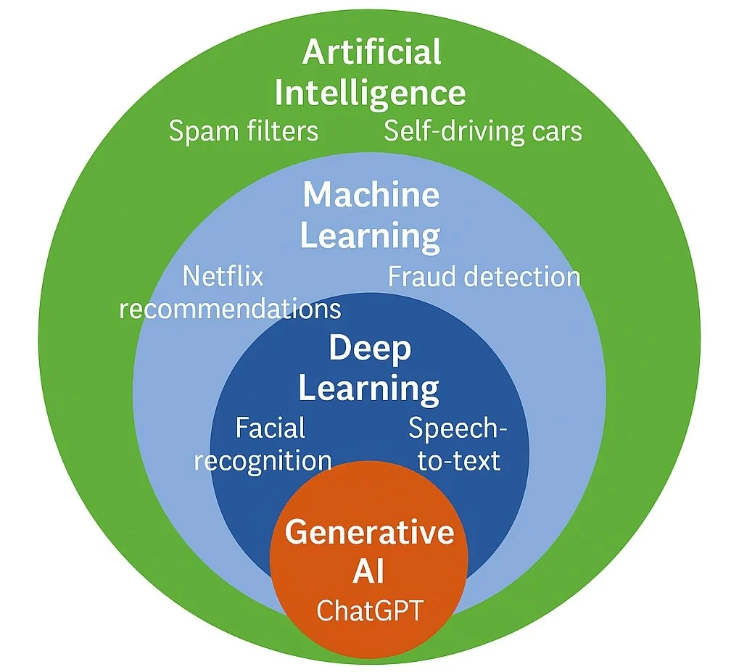
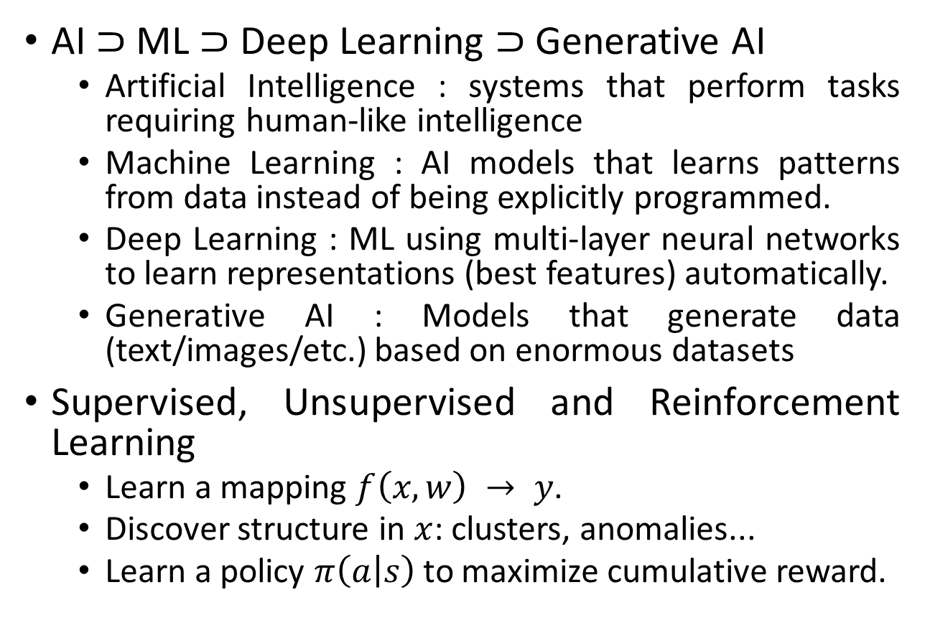
Artificial Intelligence Introduction
AI ⊃ ML ⊃ Deep Learning ⊃ Generative AI
Artificial Intelligence : systems that perform tasks requiring human-like intelligence
Machine Learning : AI models that learns patterns from data instead of being explicitly programmed.
Deep Learning : ML using multi-layer neural networks to learn representations (best features) automatically.
Generative AI : Models that generate data (text/images/etc.) based on enormous datasets
Supervised, Unsupervised and Reinforcement Learning
Learn a mapping $f\left(x,w\right) → y$.
Discover structure in $x$: clusters, anomalies...
Learn a policy $π\left(a | s\right)$ to maximize cumulative reward.
Machine Learning, Deep Learning & Generative AI
Notes:
AI is the big umbrella: systems that perform tasks that look ‘intelligent’. Machine learning is a subset where we don’t hand-code rules; we learn patterns from data. Deep learning is a subset of ML using multi-layer neural networks. And Generative AI is about producing new content—text, images, audio—typically using deep learning models trained on large datasets.

Slide 5
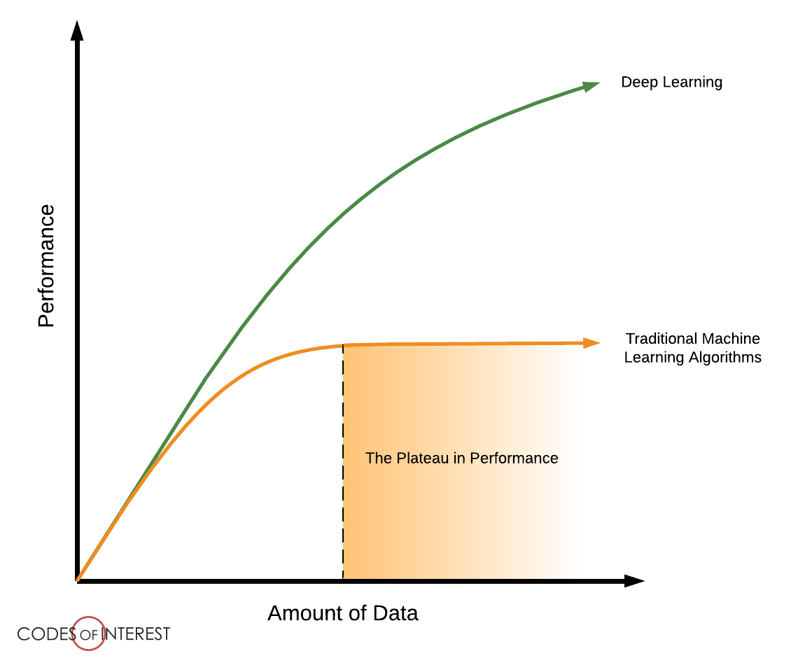
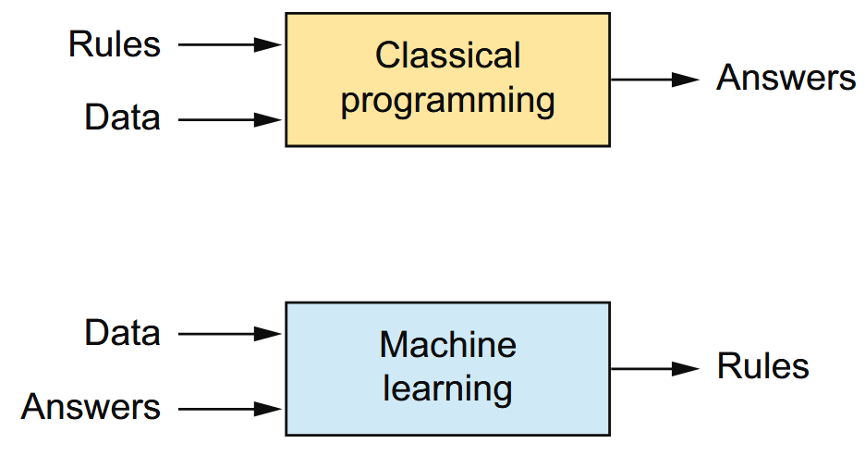
Artificial Intelligence Introduction
Machine Learning, Deep Learning & Generative AI

Slide 6
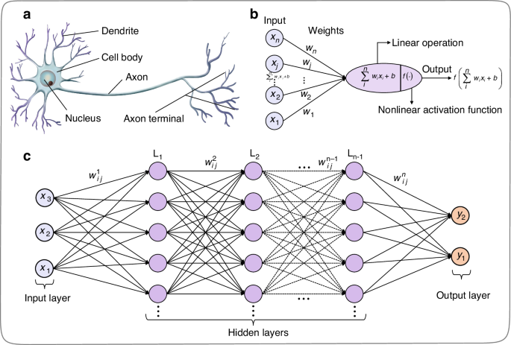
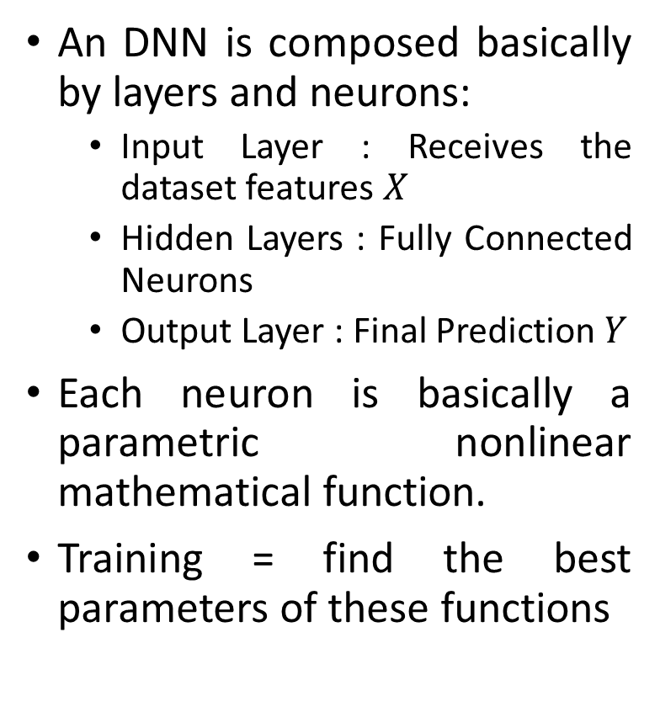
Deep Neural Network Introduction
An DNN is composed basically by layers and neurons:
Input Layer : Receives the dataset features $X$
Hidden Layers : Fully Connected Neurons
Output Layer : Final Prediction $Y$
Each neuron is basically a parametric nonlinear mathematical function.
Training = find the best parameters of these functions
Basic Structure of a Deep Neural Network
Notes:
A deep neural network is basically a function built by stacking simpler functions. Each layer mixes inputs linearly using weights, then applies a nonlinear activation. Stacking these layers gives a flexible model that can represent complex patterns.

Slide 7
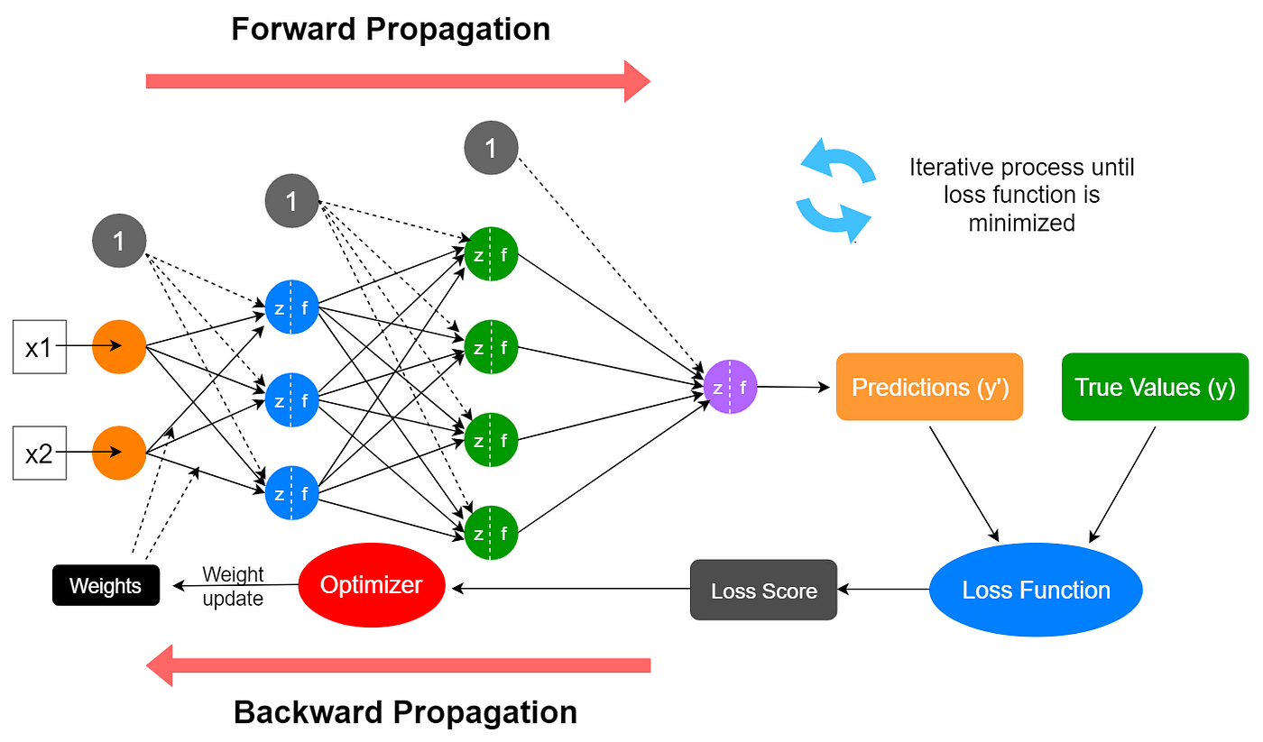
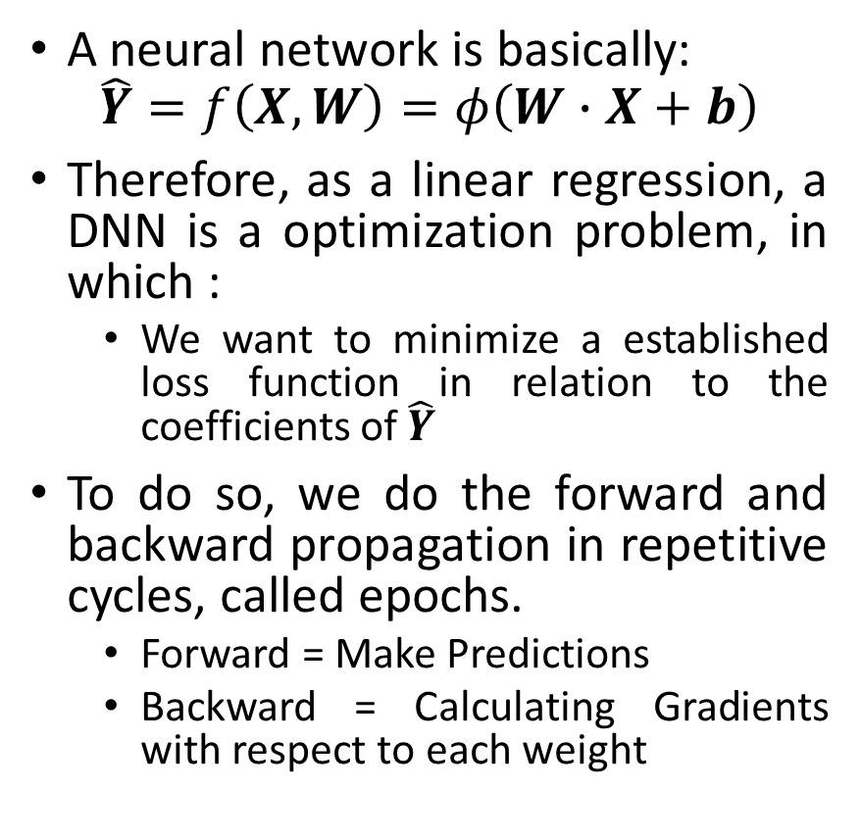
Deep Neural Network Introduction
A neural network is basically:
$$\hat{Y}=f\left(X,W\right)=φ\left(W∙X+b\right)$$
Therefore, as a linear regression, a DNN is a optimization problem, in which :
We want to minimize a established loss function in relation to the coefficients of $\hat{Y}$
To do so, we do the forward and backward propagation in repetitive cycles, called epochs.
Forward = Make Predictions
Backward = Calculating Gradients with respect to each weight
Basic Structure of a Deep Neural Network
Notes:
A deep neural network is basically a function built by stacking simpler functions. Each layer mixes inputs linearly using weights, then applies a nonlinear activation. Stacking these layers gives a flexible model that can represent complex patterns.

Slide 8
Building Blocks of Deep Learning

Slide 9
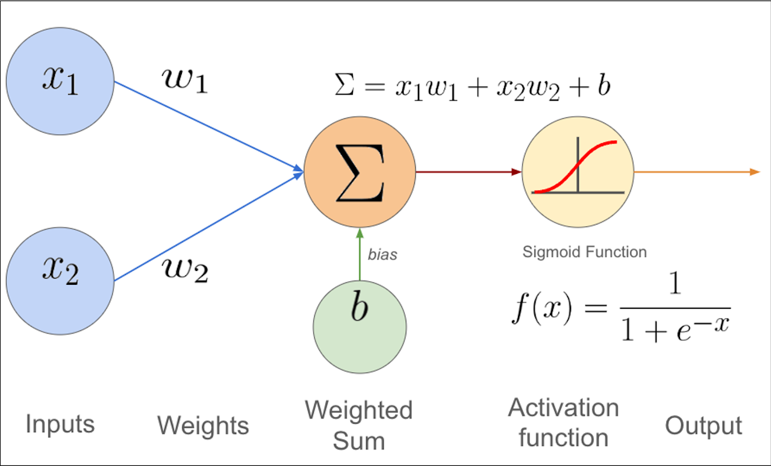

Inputs and Neurons Building Blocks of Deep Learning
To understand the Neuron Network, is important to understand each step and the flow of calculations
First, an artificial neuron, or simply a unit, generate a mathematical function :
$$One Neuron=\left\{\begin{aligned}z=w∙x+b=w_{1}x_{1}+w_{2}x_{2}+…+w_{n}x_{n}+b \\ a=φ\left(z\right)\end{aligned}\right.$$
Then, for each hidden layer, the calculation is repeated. Therefore, a DNN is just a series of weighted sum (parameters) of activation scores passing through nonlinear functions.
Forward Propagation : Inputs and Neurons
Notes:
Let’s zoom into one neuron. It takes an input vector xxx, computes a weighted sum plus a bias: z=wTx+bz = w^T x + bz=wTx+b. Then we apply an activation a=ϕ(z)a=\phi(z)a=ϕ(z). The weights control what the neuron is ‘looking for’ in the input. The bias shifts the threshold. This is the basic building block of deep learning

Slide 10
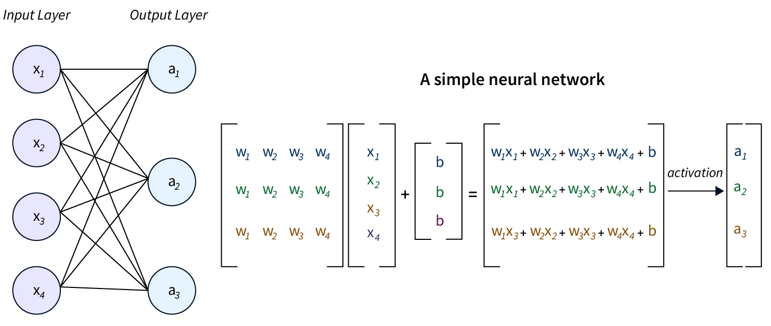
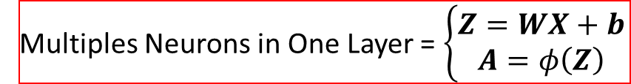

Inputs and Neurons Building Blocks of Deep Learning
Multiples Neurons in One Layer = $\left\{\begin{aligned}Z=WX+b \\ A=φ\left(Z\right)\end{aligned}\right.$
$$W$$
X
Z
A
b
Importance with the initialization of weights !
Breaking the Symmetry !
Forward Propagation : Inputs and Neurons
Notes:
Now we stack neurons into layers. In layer lll, we compute z(l)=W(l)a(l−1)+b(l)z^{(l)} = W^{(l)}a^{(l-1)} + b^{(l)}z(l)=W(l)a(l−1)+b(l), then apply the activation a(l)=ϕ(l)(z(l))a^{(l)}=\phi^{(l)}(z^{(l)})a(l)=ϕ(l)(z(l)). The full network is just repeating this until the output y^\hat{y}y^​. This computation is the forward pass.

Slide 11
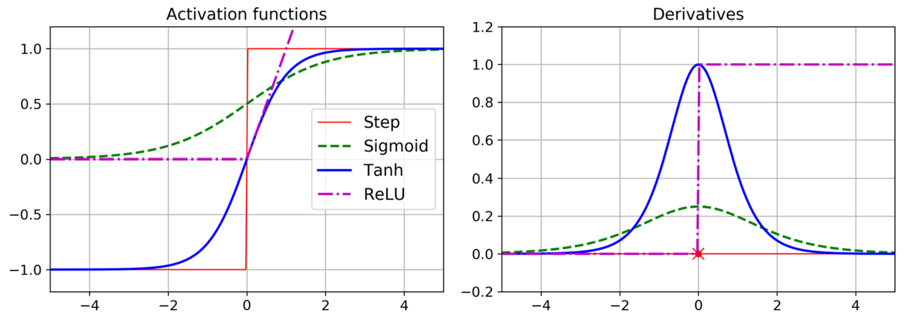

Activation Functions Building Blocks of Deep Learning
A key point in neural networks is that they do not work well if all activation functions are linear (the network then collapses to a single linear model).
To extract features and represent nonlinear patterns in data, we choose nonlinear activation functions.
Good activation functions are typically differentiable (or almost everywhere), have stable gradients, are numerically stable, are computationally efficient, and have useful statistical properties.
$${\begin{aligned}Sigmoid\left(z\right)=\frac{1}{1+e^{−z}} \\ ReLU\left(z\right)=\max\left(0,z\right)\end{aligned} \atop \begin{aligned}Tanh\left(z\right)=\frac{e^{z}−e^{−z}}{e^{z}+e^{−z}} \\ ELU\left(z\right)=\left\{\begin{aligned}z z≥0 \\ α\left(e^{z}−1\right) z<0\end{aligned}\right.\end{aligned}}$$
Forward Propagation : Activation Functions
Notes:
If all activations were linear, stacking layers would still be a linear function—so depth would not help. Nonlinear activations make the model expressive. ReLU is popular because it’s simple and helps gradients flow. Sigmoid/softmax are often used at the output to represent probabilities.

Slide 12
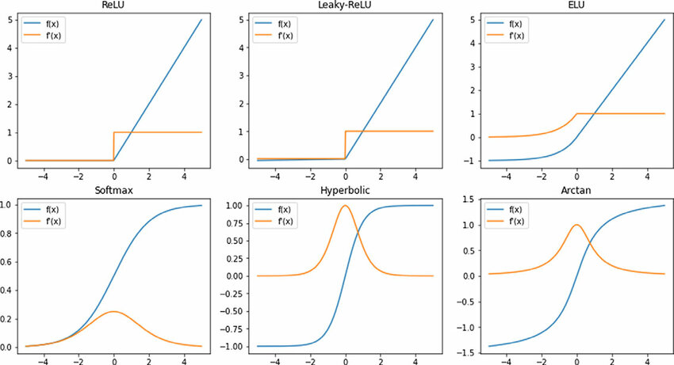
Activation Functions Building Blocks of Deep Learning
Universal Approximation : “A sufficiently large neural network with nonlinear activations can approximate any continuous function.”
This explains why deep networks can learn rich representations (“feature extraction”).
Forward Propagation : Activation Functions
Notes:
There’s a classic result: sufficiently large neural networks with nonlinear activations can approximate a wide class of functions. In practice, deep networks are useful because they can learn representations—features—automatically, often more efficiently than shallow models.

Slide 13
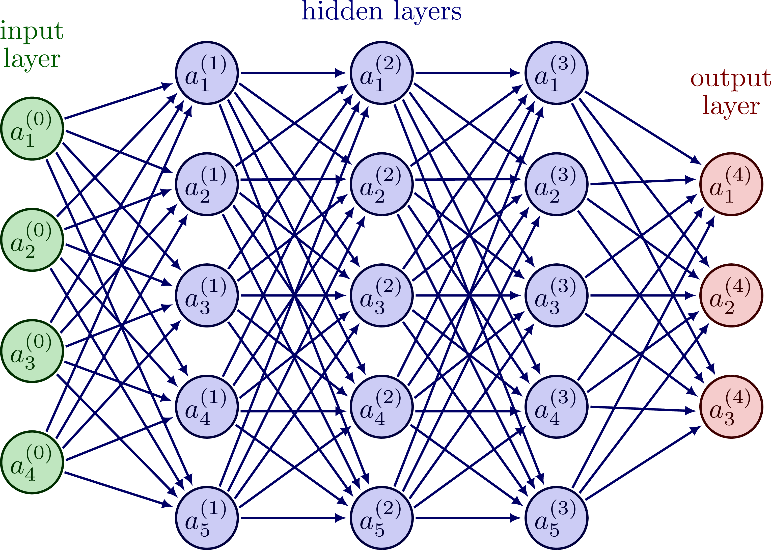


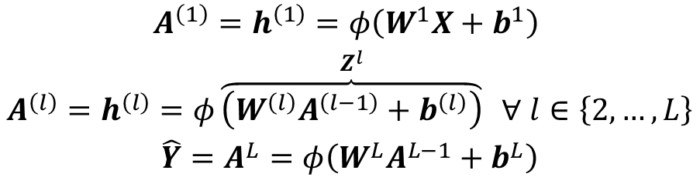
Multi-Layer Networks Building Blocks of Deep Learning
A DNN can be written as a composition of layers:
Or in a more condensed form :
This computation is called the forward pass (or forward propagation).
Note: there is no single universal naming convention for network notation.
$${{A^{\left(1\right)}=h}^{\left(1\right)}=φ\left(W^{1}X+b^{1}\right) \atop \begin{aligned}{A^{\left(l\right)}=h}^{\left(l\right)}=φ\overset{Z^{l}}{\overbrace{\left(W^{\left(l\right)}A^{\left(l−1\right)}+b^{\left(l\right)}\right)}} ∀ l∈\left\{2,…,L\right\} \\ \hat{Y}=A^{L}=φ\left(W^{L}A^{L−1}+b^{L}\right)\end{aligned}}$$
$$\hat{y}=f\left(X,W\right)=\left(f^{L}∘f^{L−1}∘…∘f^{1}\right)\left(X\right)$$
$$=φ\left\{W^{L}\left[φ\left(…\right)\right]+b^{L}\right\}$$
Forward Propagation

Slide 14
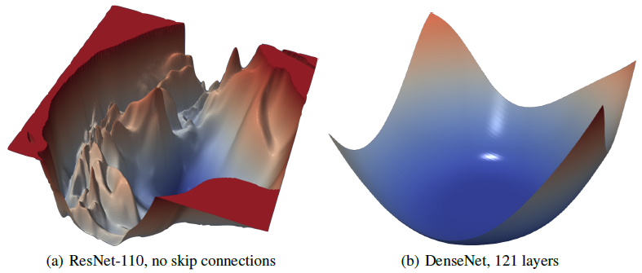
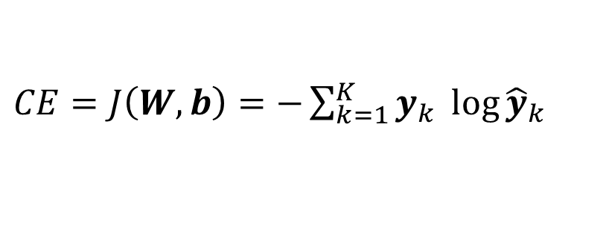


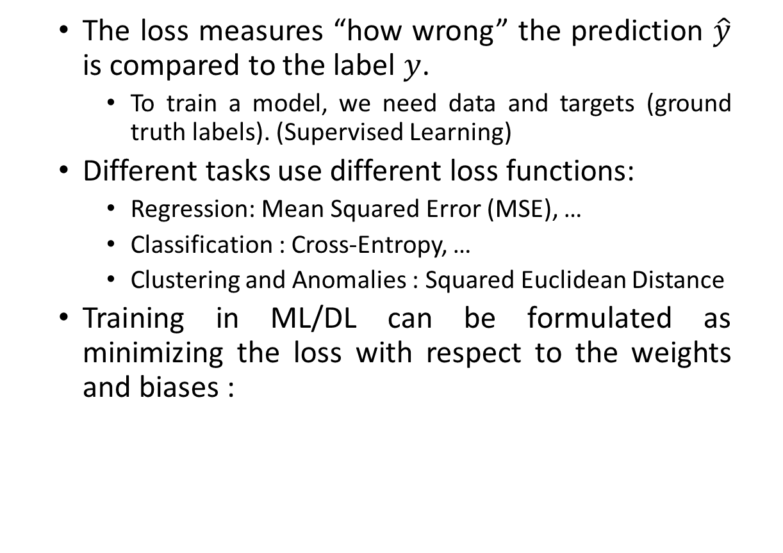
Prediction and Loss Function Building Blocks of Deep Learning
The loss measures “how wrong” the prediction $\hat{y}$ is compared to the label $y$.
To train a model, we need data and targets (ground truth labels). (Supervised Learning)
Different tasks use different loss functions:
Regression: Mean Squared Error (MSE), …
Classification : Cross-Entropy, …
Clustering and Anomalies : Squared Euclidean Distance
Training in ML/DL can be formulated as minimizing the loss with respect to the weights and biases :
$MSE=J\left(W,b\right)=\frac{1}{2m}\sum_{i=1}^{m}{{\left({\hat{y}}_{i}−y_{i}\right)}^{2}}$
$CE=J\left(W,b\right)=−\sum_{k=1}^{K}{y_{k} \log{{\hat{y}}_{k}}}$
$${\left(W,b\right)}^{∗}=\arg{\min_{\left(W,b\right)}{J\left(W,b\right)}}$$
Non-convex optimization in DNNs: Nonlinear activation functions + millions of parameters = a highly non-convex loss surface
Forward Propagation : Prediction and Cost Function
Notes:
The network outputs a prediction y^\hat{y}y^​. To learn, we need a loss function that tells us how wrong we are compared to the true label yyy. Training becomes an optimization problem: find parameters θ\thetaθ that minimize the average loss over the dataset.

Slide 15
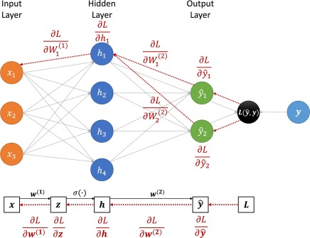

Backward Propagation Building Blocks of Deep Learning
$$W_{new}=W_{old}−α∇_{W}J$$
With the goal of minimizing the loss function, training a DNN becomes an optimization problem.
Several optimization algorithms exist (e.g., Newton–Raphson), but in practice we most often use gradient descent and its variants, such as Adam (Adaptive Moment Estimation).
Gradients are computed efficiently using the backpropagation algorithm (chain rule) and automatic differentiation.
Backward Propagation : Automatic Differentiation and Weights Adjustment
Notes:
To reduce the loss, we need to know how each parameter influences it. Backpropagation applies the chain rule efficiently to compute gradients of the loss with respect to every weight and bias. These gradients tell us the direction to change parameters to reduce the loss

Slide 16
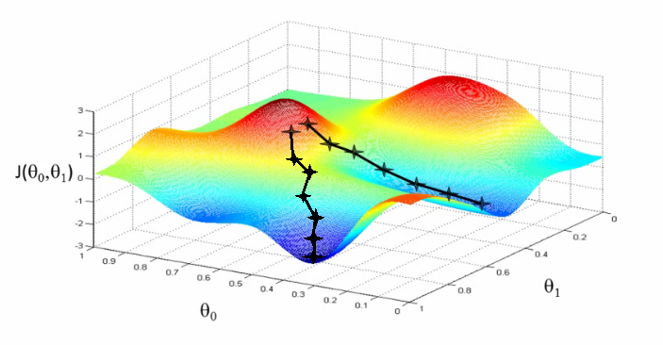
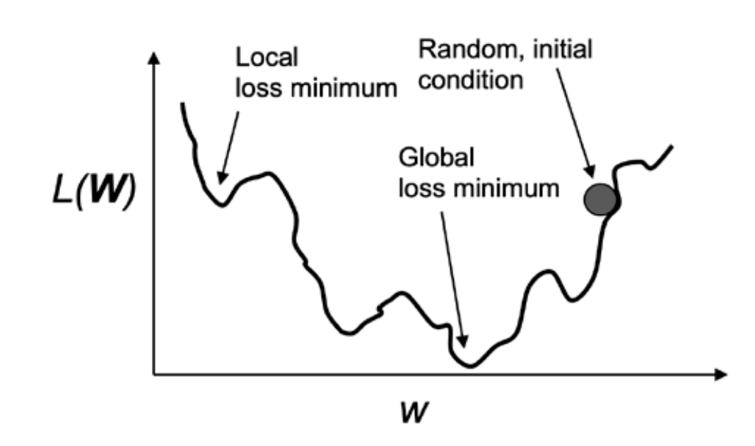
Optimization and Regularization Building Blocks of Deep Learning
Adam combines gradient information with moving averages (momentum-like terms) and adaptive learning rates.
Key training concepts:
Learning rate: step size used to update parameters
Batch: a small subset of training samples
Epoch: one full pass through the training dataset
Regularization helps prevent overfitting, fast weight adjustment and smooth the loss surface : L1/L2 (weight decay), dropout, early stopping, …
Backward Propagation : Regularization
Notes:
A model can fit the training data too well and fail on new data—that’s overfitting. Regularization adds constraints or noise to encourage simpler solutions. Common examples are L2 weight decay, dropout, and early stopping.

Slide 17
Evaluation

Slide 18
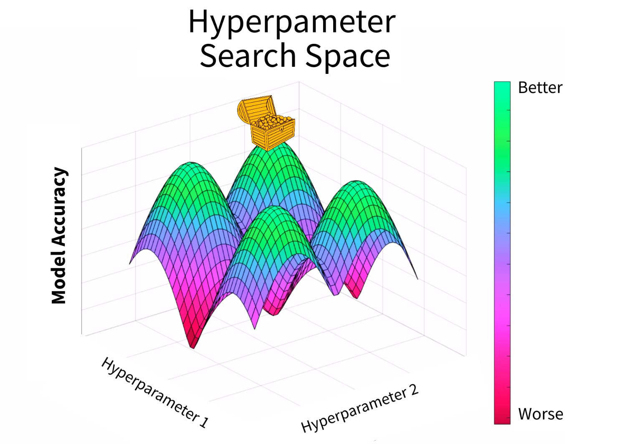
Final Model Evaluation
To define the final model, we choose design criteria based on the objective.
A common diagnostic is the loss curve: lower loss often indicates a better fit (but not always better generalization).
We typically split the data into train, validation, and test subsets.
Learned Parameters : Weights and Biases
Hyperparameters (chosen): learning rate, batch size, weight decay, …
We search for good hyperparameters using methods such as grid search and hyperparameter tuning.
Main drawback: computational cost (time).
Evaluation : Final Model & GridSearch
Notes:
After training, we still need to decide hyperparameters like learning rate, batch size, weight decay, number of layers. We tune these using the validation set, then report final performance once on the test set. Grid search is a simple method: try combinations and keep the best.

Slide 19
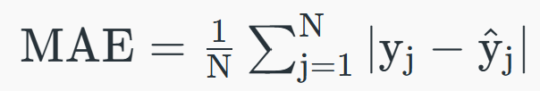
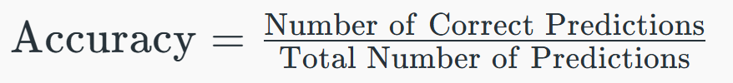
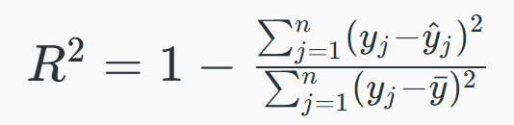
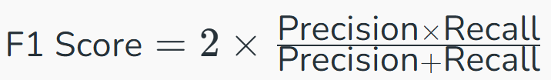
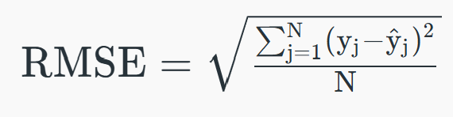
Error Metrics Evaluation
Beyond the loss, we use evaluation metrics and diagnostic plots.
The choice of metric depends on the task: classification, regression, or probability estimation.
Evaluation : Error Metrics
Notes:
Loss is what we optimize during training, but metrics are what we use to interpret performance. For classification we often use accuracy, precision/recall, F1. For regression we use MAE or MSE. The choice depends on what errors matter in your application.

Slide 20
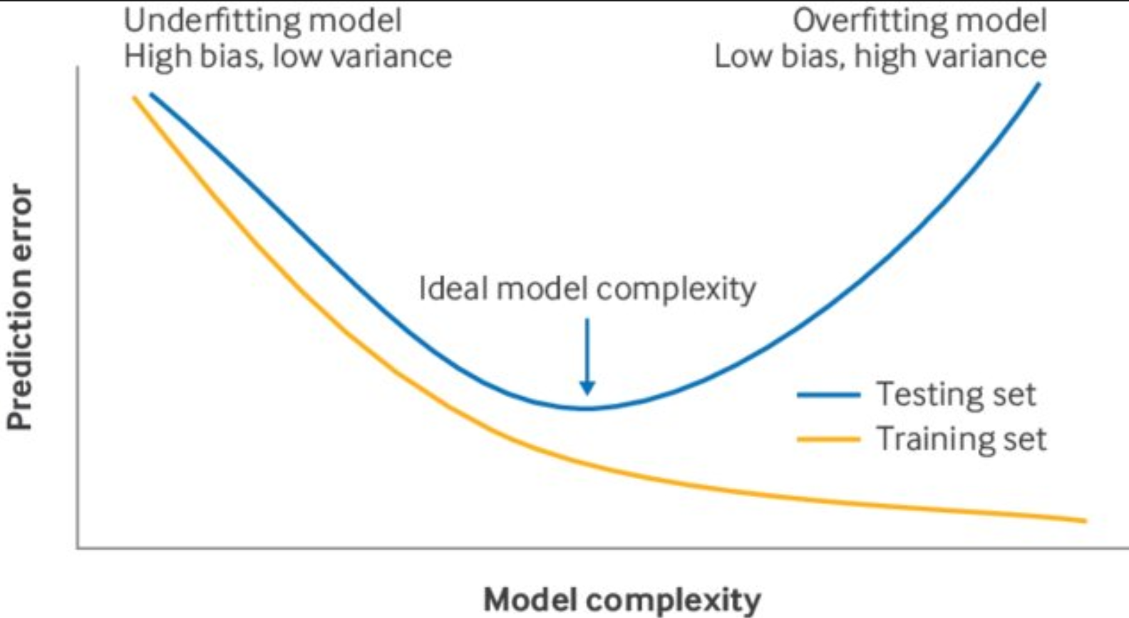
Learning Curves & Under/ Overfitting Evaluation
A major challenge in deep learning is underfitting vs overfitting.
Underfitting: high bias (model too simple; performs poorly even on training data) (Human perf. - prediction)
Overfitting: high variance (model fits training data well but generalizes poorly) (Validation - prediction)
Optimal : low bias, low variance. (Between both)
We diagnose this using learning curves (loss vs epochs).
Related tools: validation curves, error curves.
Evaluation : Final Model & GridSearch
Notes:
Learning curves are one of the fastest ways to debug training. If both training and validation losses are high, the model underfits. If training loss is low but validation loss stops improving or increases, the model overfits. This guides what to change: model size, regularization, data, or training time

Slide 21
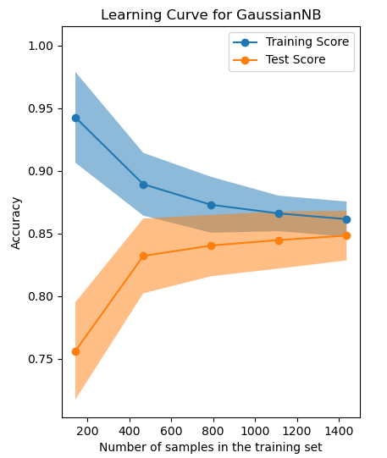
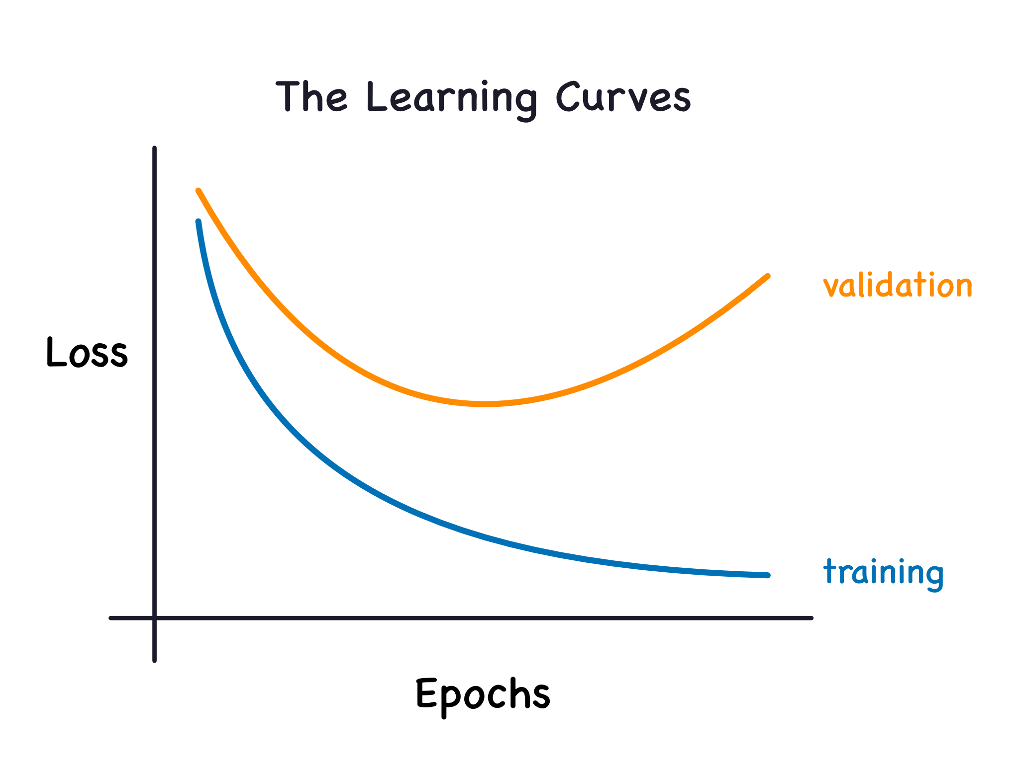
Learning Curves & Under/ Overfitting Evaluation
Evaluation : Final Model & GridSearch

Slide 22
Merci ! Thank you! Obrigado! 谢谢 !
jose-antonio.miranda-mattei@insa-lyon.fr / songhao.gao@insa-lyon.fr
Notes:
Thanks for your attention. If you want, I can also share a tiny PyTorch snippet that shows the forward pass, loss, and optimizer steps in a few lines.

